Slide 1
Vaccine Effectiveness
Hyunbeen Kim
Department of Microbiology
Korea university college of Medicine

Slide 2
Vaccine effectiveness (VE)
 | Moscow 1999 | Fujian 2002 | California2004 | Wisconsin 2005 | Brisbane 2007 | Perth 2009 | Victoria 2011 | Switzerland 2013 | Hongkong 2015 | Kansas 2017
HA mutation | 25.54 | 10.48 | 5.89 | 5.72 | 4.81 | 10.08 | 11.58 | 4.02 | 4.11 | 1.73
 | 1999 | 2000 | 2001 | 2002 | 2003 | 2004 | 2005 | 2006 | 2007 | 2008
Mismatch | - | - | - | - | Y | Y | N | N | N | N
VE (%) | 8.8 | - | - | - | - | 9 | 36 | 41 | 54 | 51
 | 2009 | 2010 | 2011 | 2012 | 2013 | 2014 | 2015 | 2016 | 2017 | 2018
Mismatch | - | N | Y | Y | N | N | - | - | - | -
VE (%) | - | 42.5 | 39 | 39 | 11 | 6 | 54 | 33 | 22 | 9
Egg adaptation

Slide 3
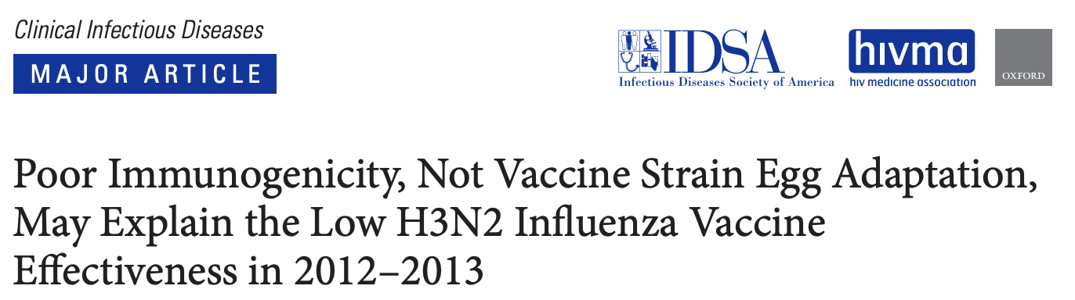
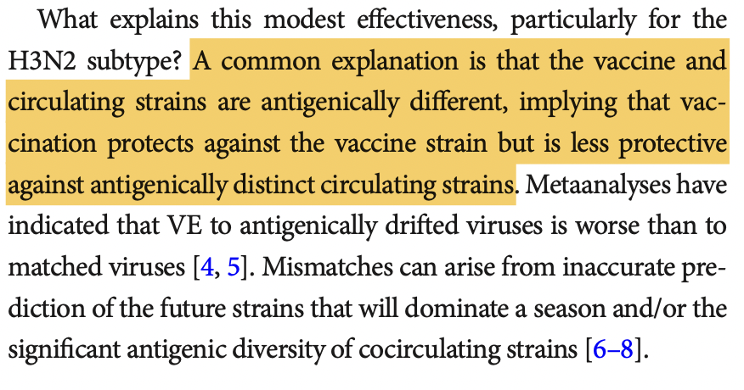
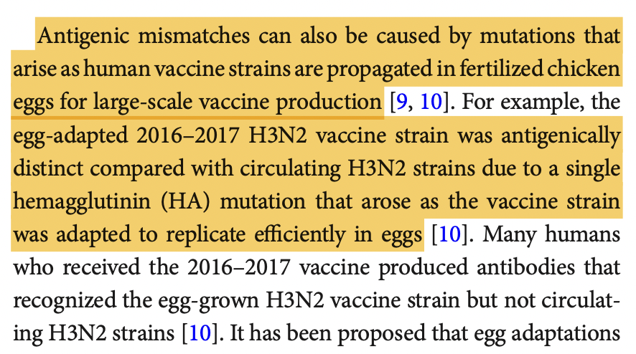
Egg adaptation
https://pubmed.ncbi.nlm.nih.gov/29471464/

Slide 4
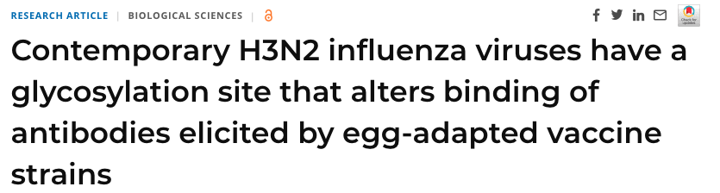
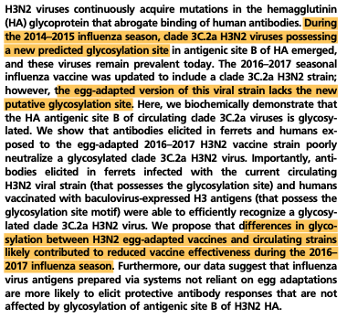
Egg adaptation
https://www.pnas.org/doi/10.1073/pnas.1712377114

Slide 5
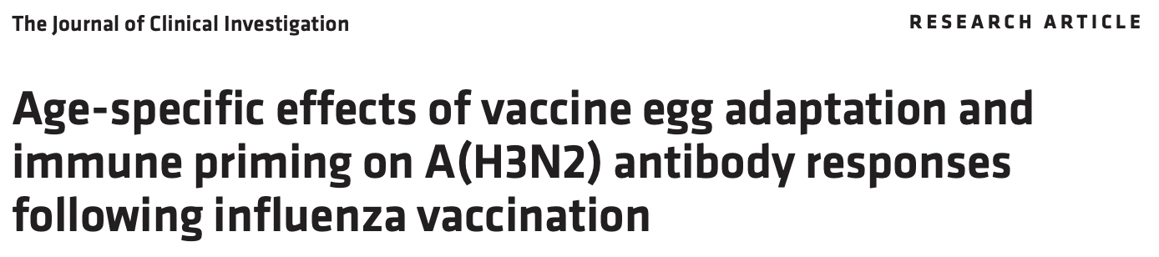
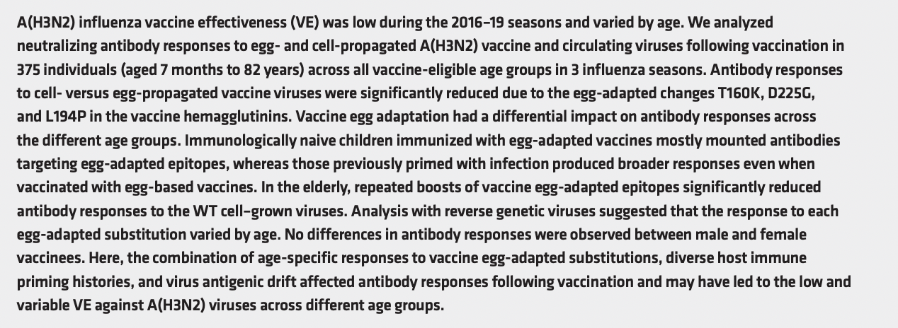
Egg adaptation

Slide 6
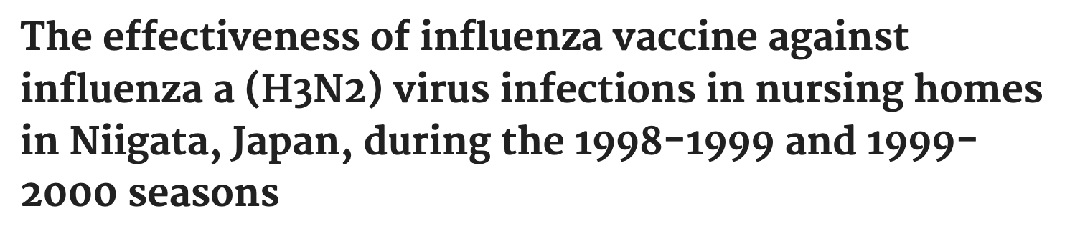
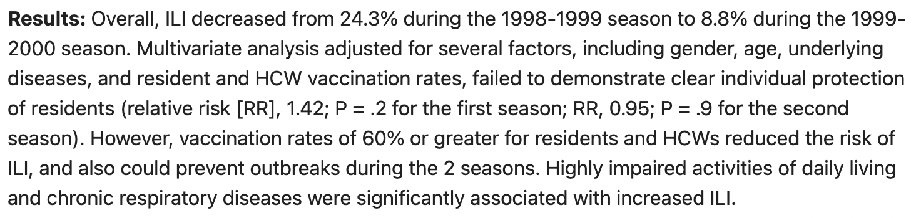
Reference
https://pubmed.ncbi.nlm.nih.gov/11893153/

Slide 7
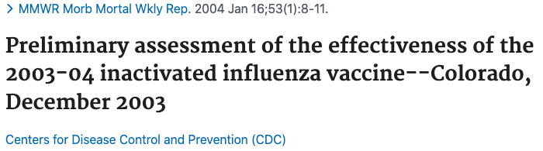
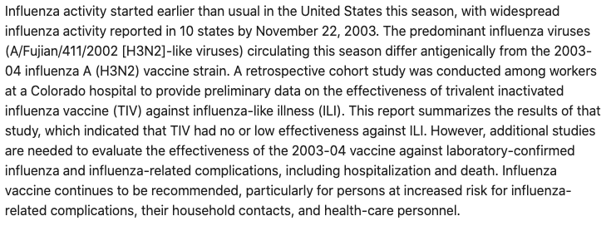
Reference
https://pubmed.ncbi.nlm.nih.gov/14724559/

Slide 8
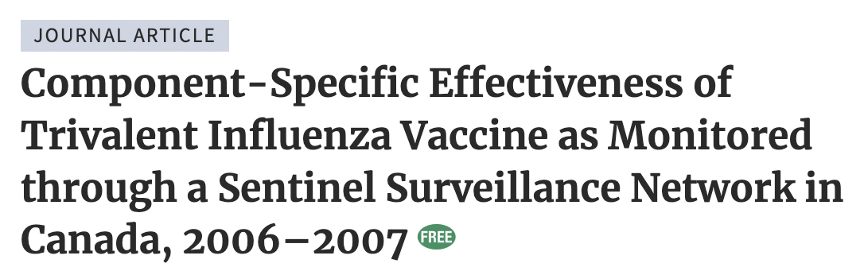
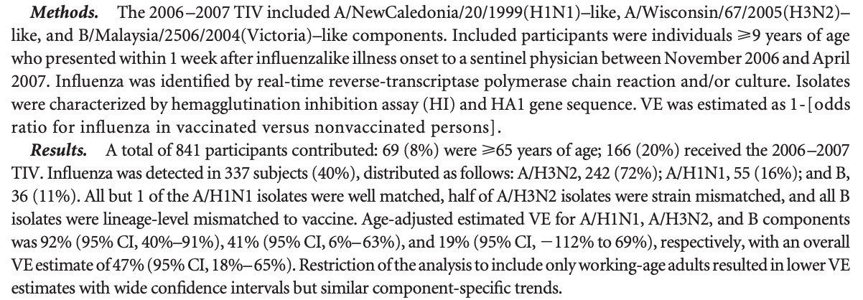
Reference
https://pubmed.ncbi.nlm.nih.gov/19086914/

Slide 9

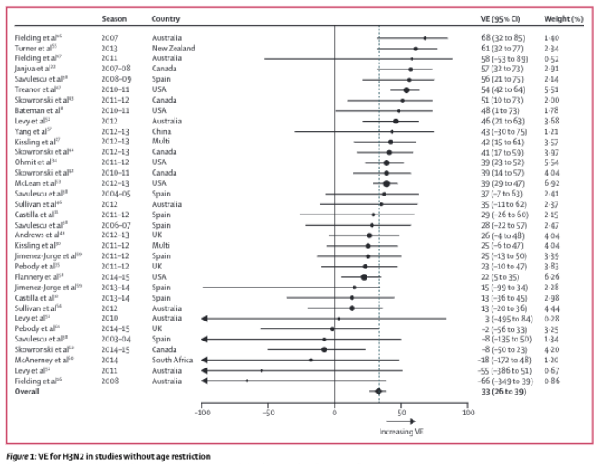
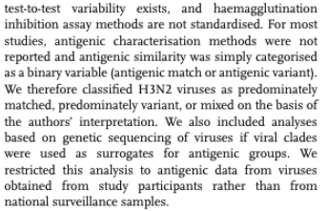
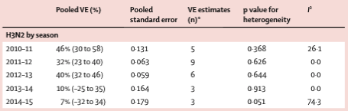
Reference
https://pubmed.ncbi.nlm.nih.gov/27061888/

Slide 10
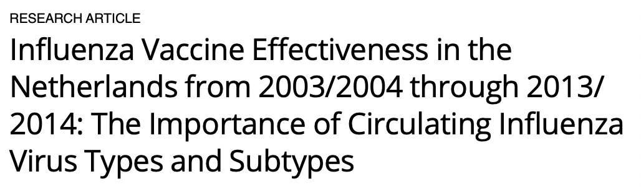
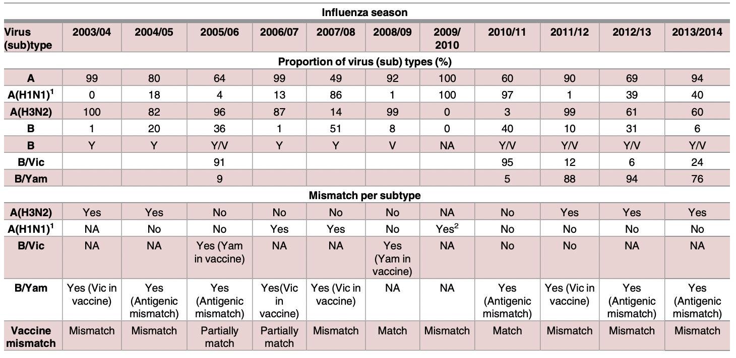
Reference
HI or RT-PCR
https://pubmed.ncbi.nlm.nih.gov/28068386/

Slide 11

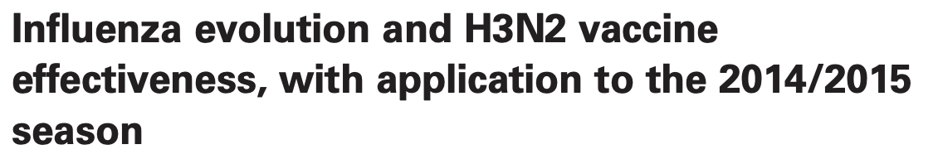
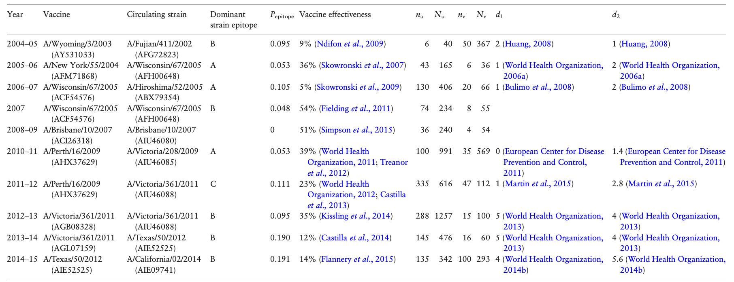

Reference
https://pubmed.ncbi.nlm.nih.gov/27313229/

Slide 12
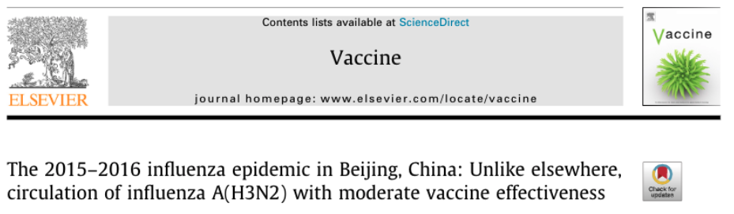
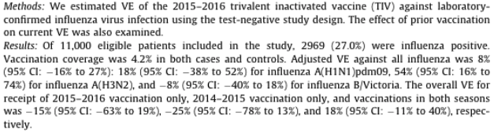
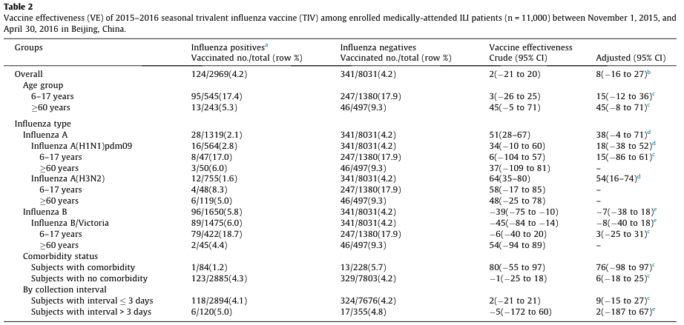
Reference
https://pubmed.ncbi.nlm.nih.gov/30017144/

Slide 13

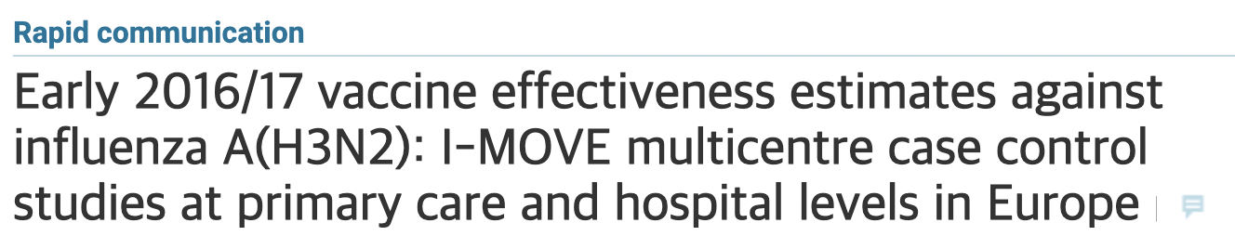
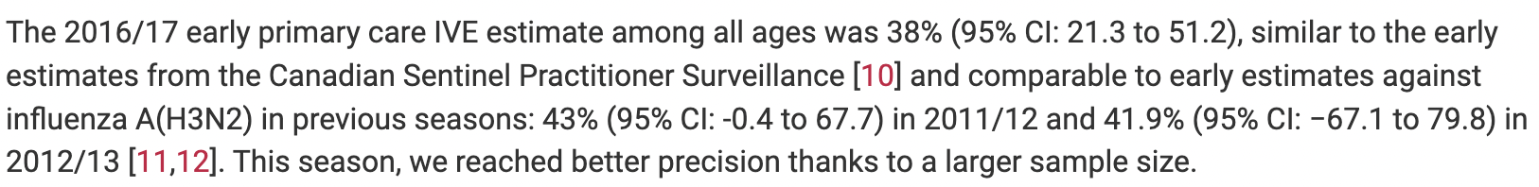
Reference
https://www.eurosurveillance.org/content/10.2807/1560-7917.ES.2017.22.7.30464

Slide 14
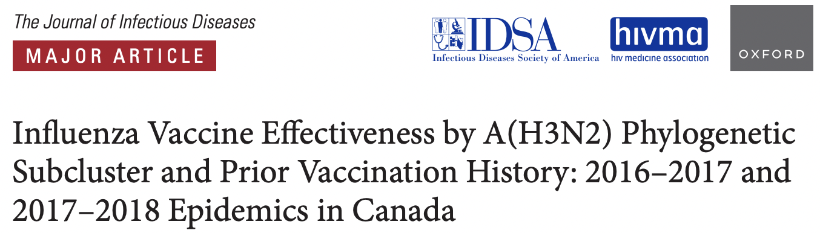
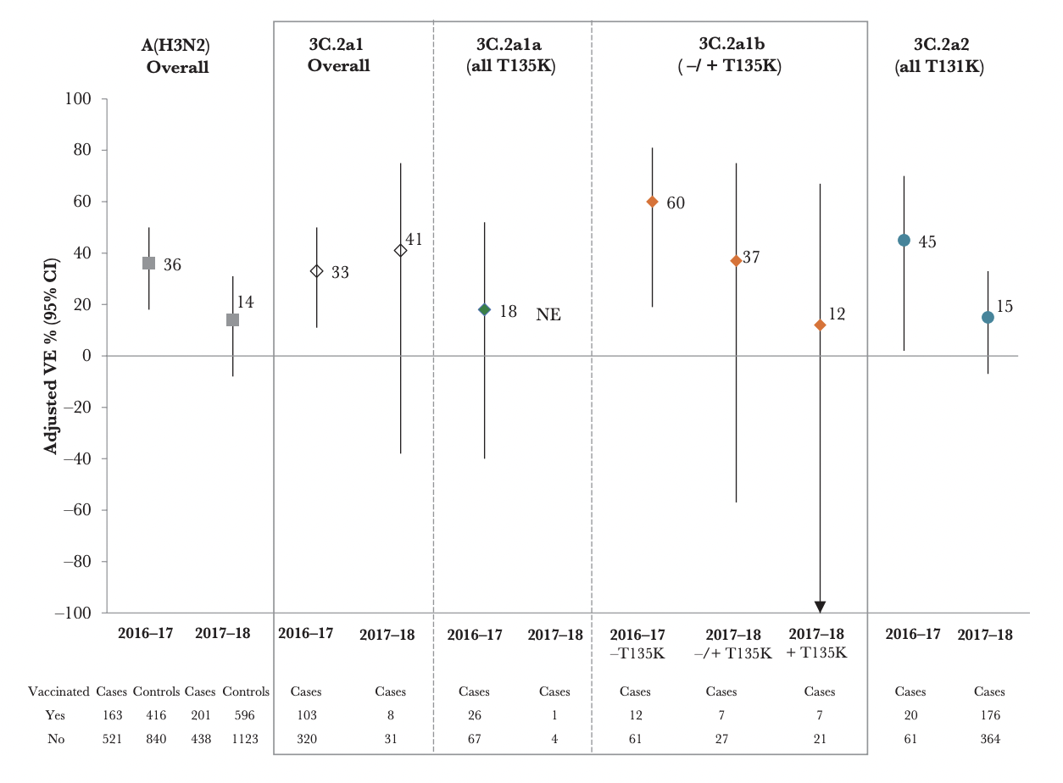
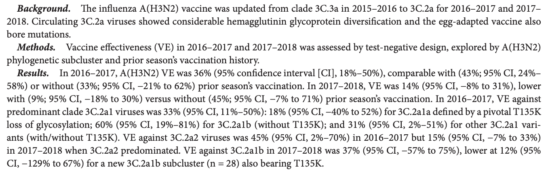
Reference
https://pubmed.ncbi.nlm.nih.gov/32215564/

Slide 15



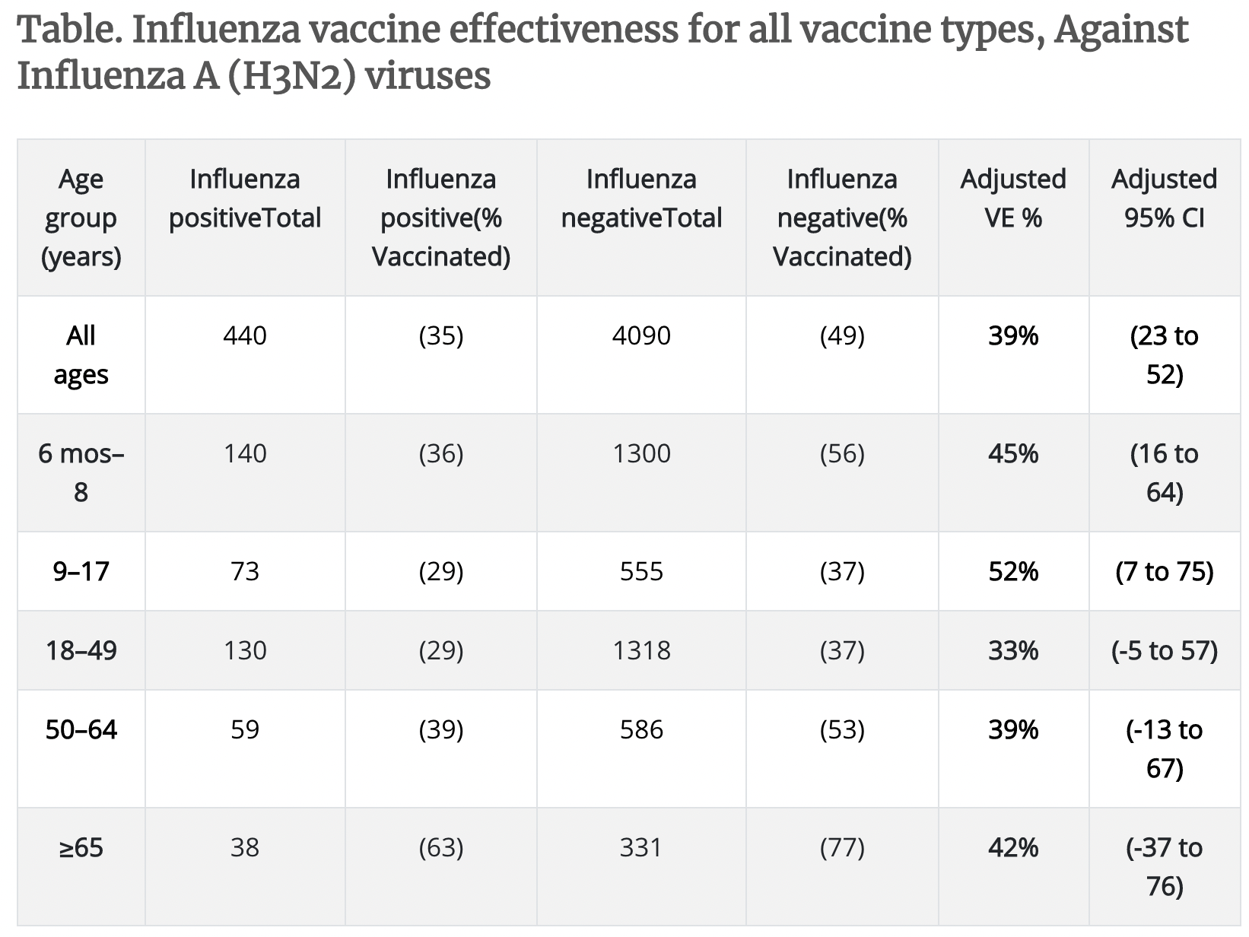
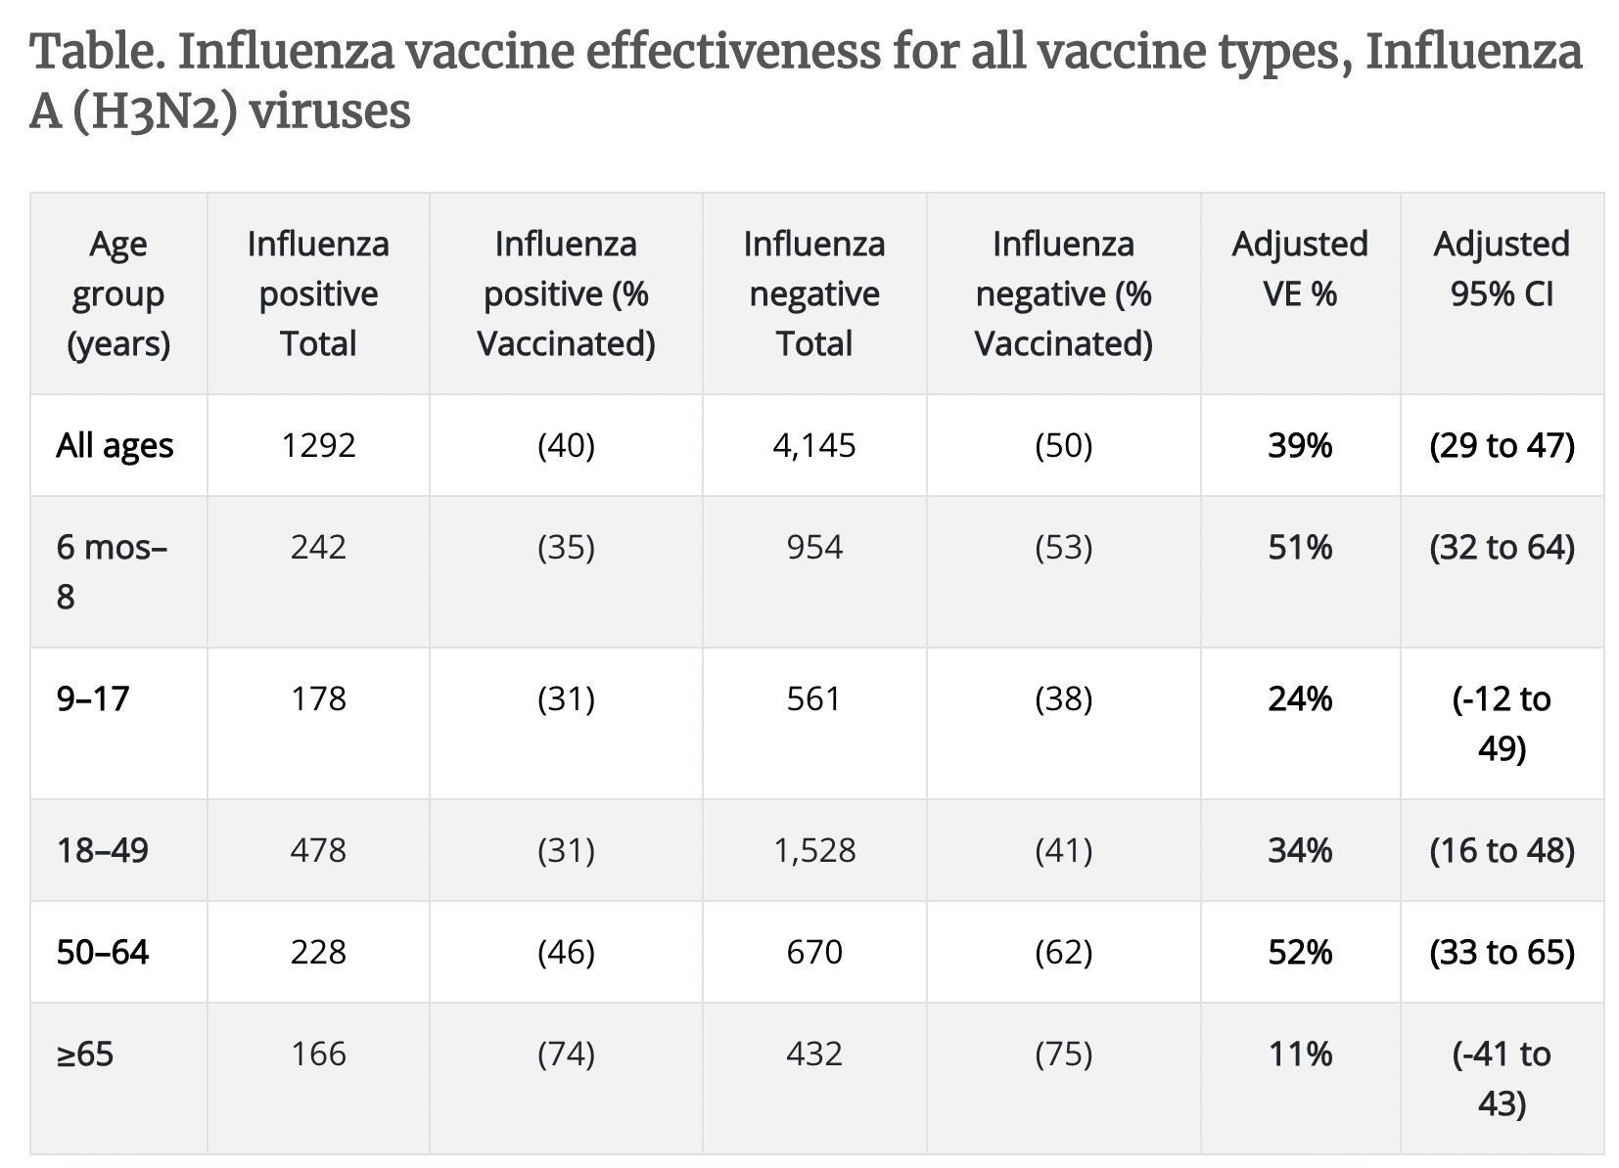
Reference

Slide 16


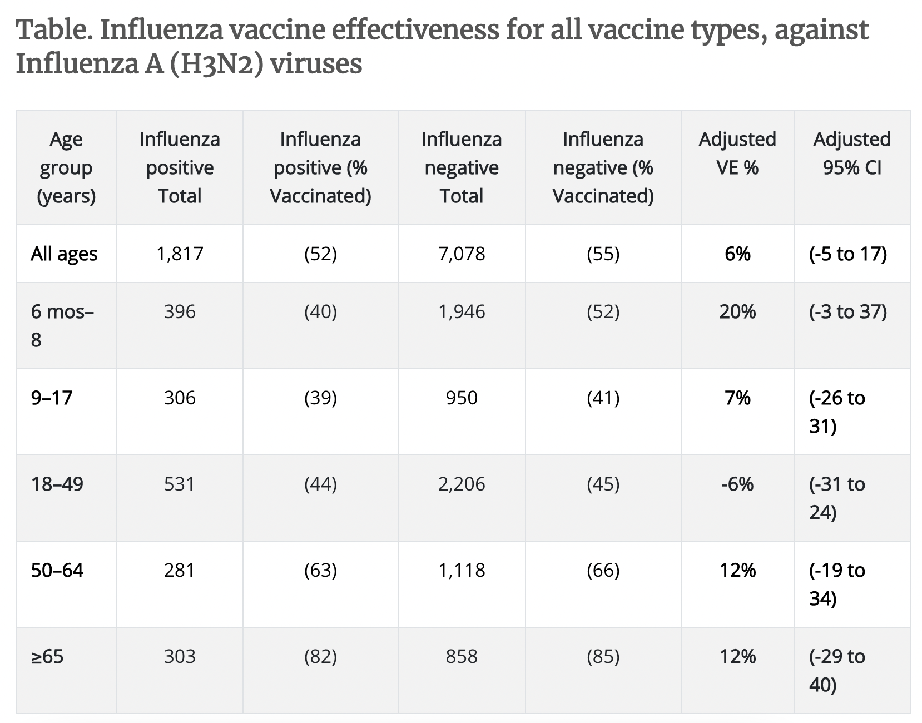
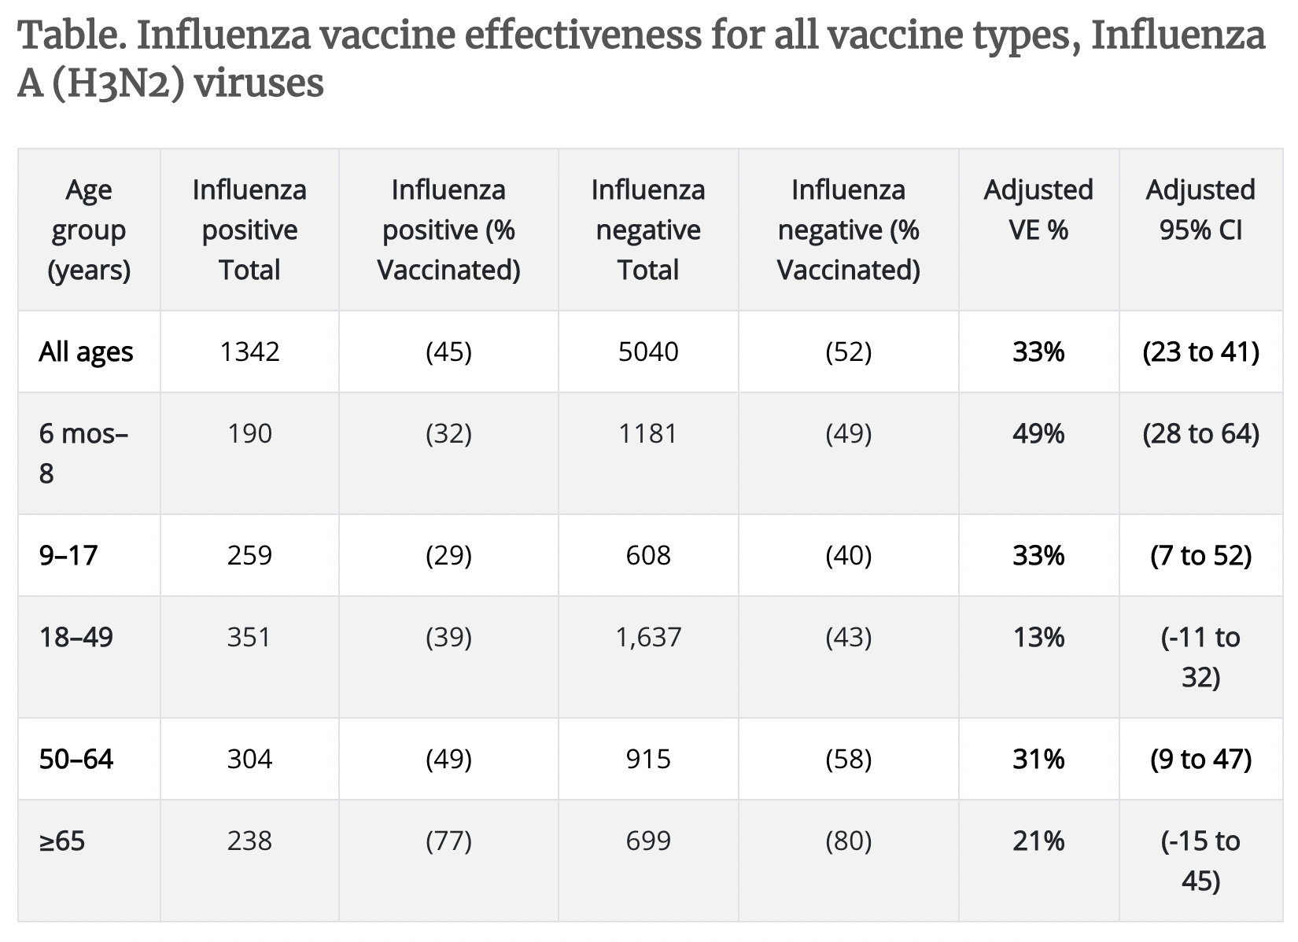
Reference

Slide 17


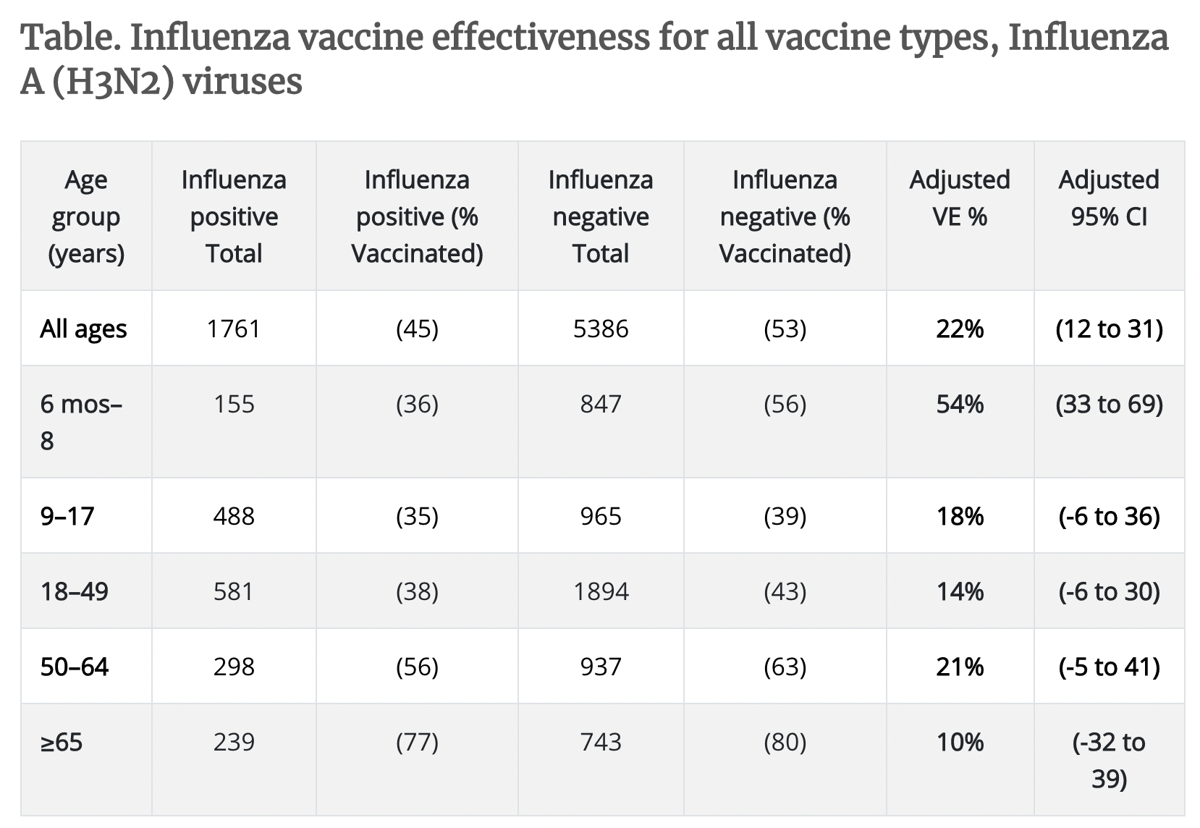
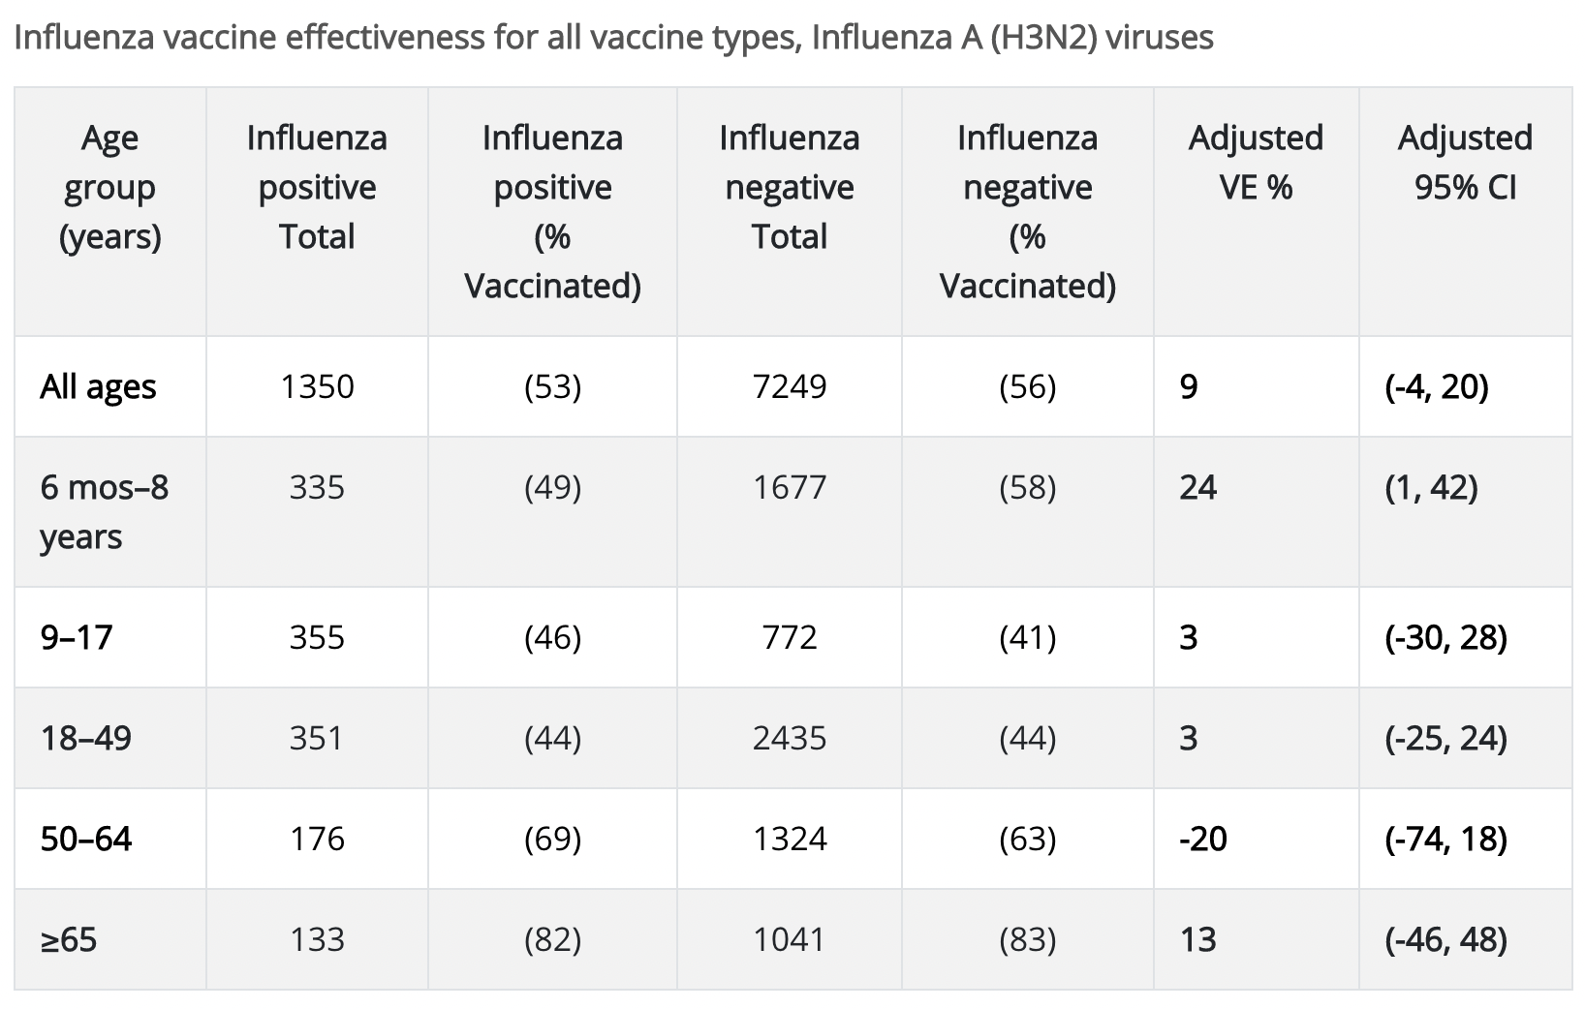
Reference

Slide 18
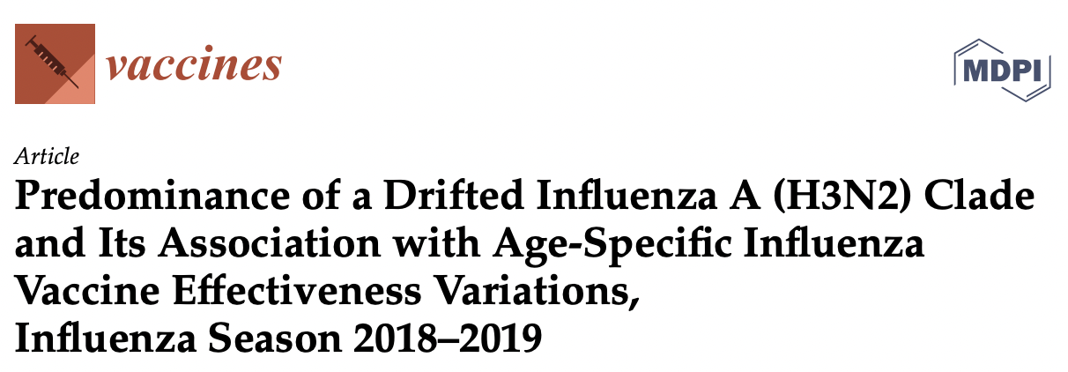
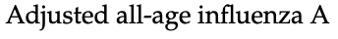
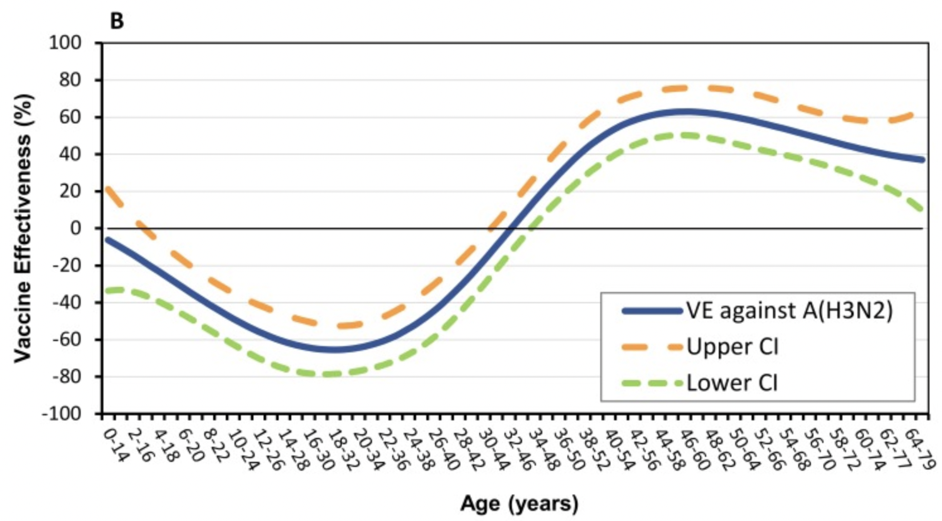
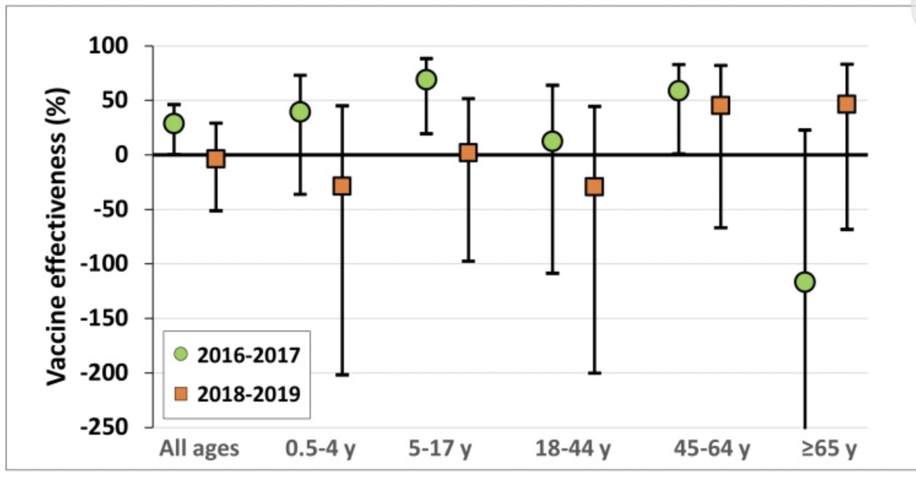
Reference
https://pubmed.ncbi.nlm.nih.gov/28180277/

